Slide 1

CRYPTOGRAPHY
A.K.M. MEHEDI HASAN
Lecturer
CSE,BUET

Slide 2
Cryptography
Cryptography is the study of secure communications techniques that allow only the sender and intended recipient of a message to view its contents.
ABC (meaningful message)-> ZYX(cipher)

Slide 3
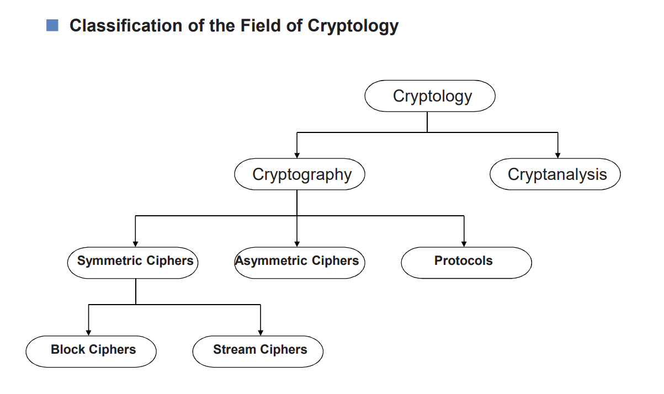
CRYPTOGRAPHY
A.K.M. MEHEDI HASAN
Lecturer
CSE,BUET

Slide 4
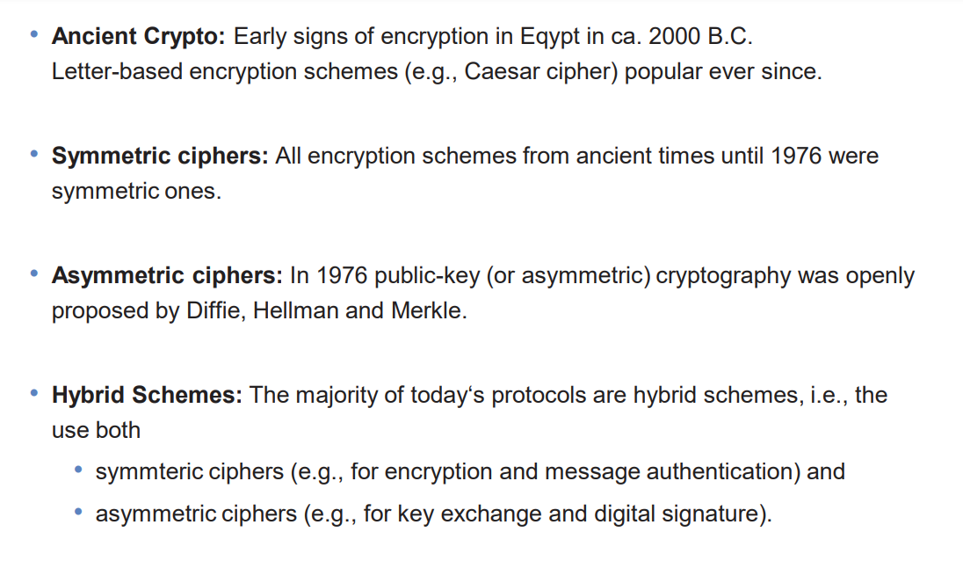

Slide 5
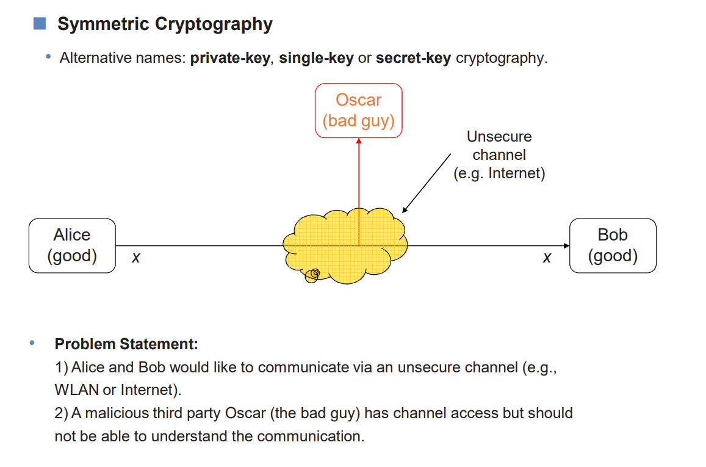

Slide 6
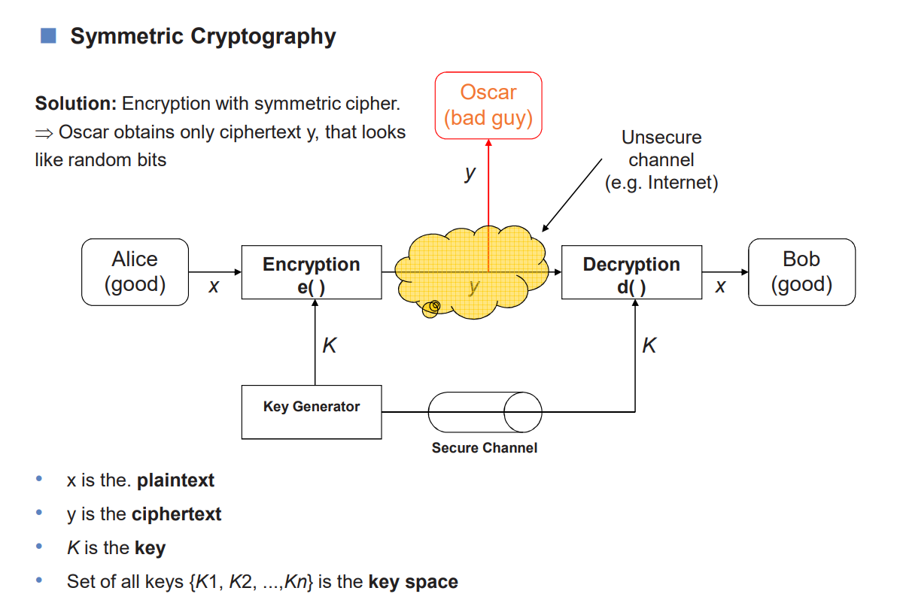

Slide 7
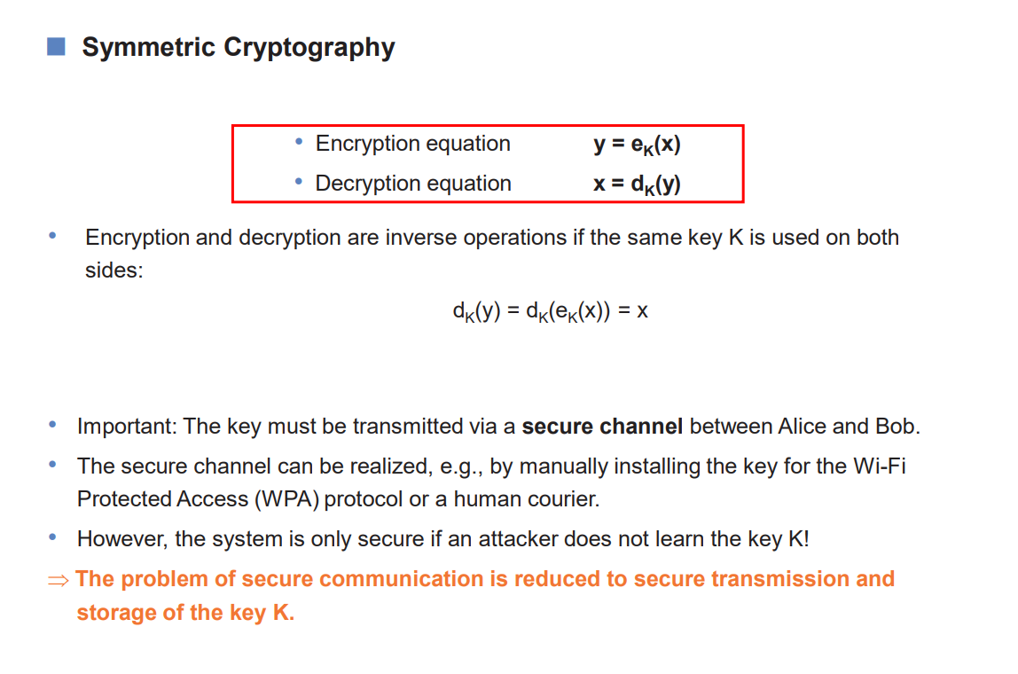

Slide 8
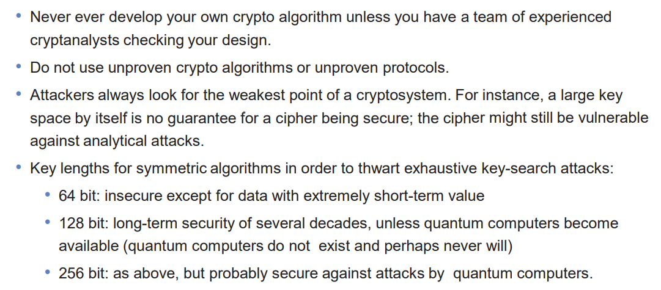
Things to be remembered

Slide 9
What is AES?
AES is an encryption standard chosen by the National Institute of Standards and Technology(NIST), USA to protect classified information. It has been accepted world wide as a desirable algorithm to encrypt sensitive data.
It is a block cipher which operates on block size of 128 bits for both encrypting as well as decrypting.
Each Round performs similar operations.

Slide 10
Why AES?
In 1990's the cracking of DES algorithm became possible.
Around 50 hours of brute-forcing allowed to crack the message.
NIST started searching for new feasible algorithm and proposed its requirement in 1997.
In 2001 Rijndael algorithm designed by Rijment and Daemon of Belgium was declared as the winner of the competition.
It met all Security, Cost and Implementation criteria.

Slide 11
How Does AES work?
AES basically repeats 4 major functions to encrypt data. It takes 128 bit block of data and a key and gives a ciphertext as output.The functions are:
Substitute Bytes
Shift Rows
Mix Columns
Add Key

Slide 12
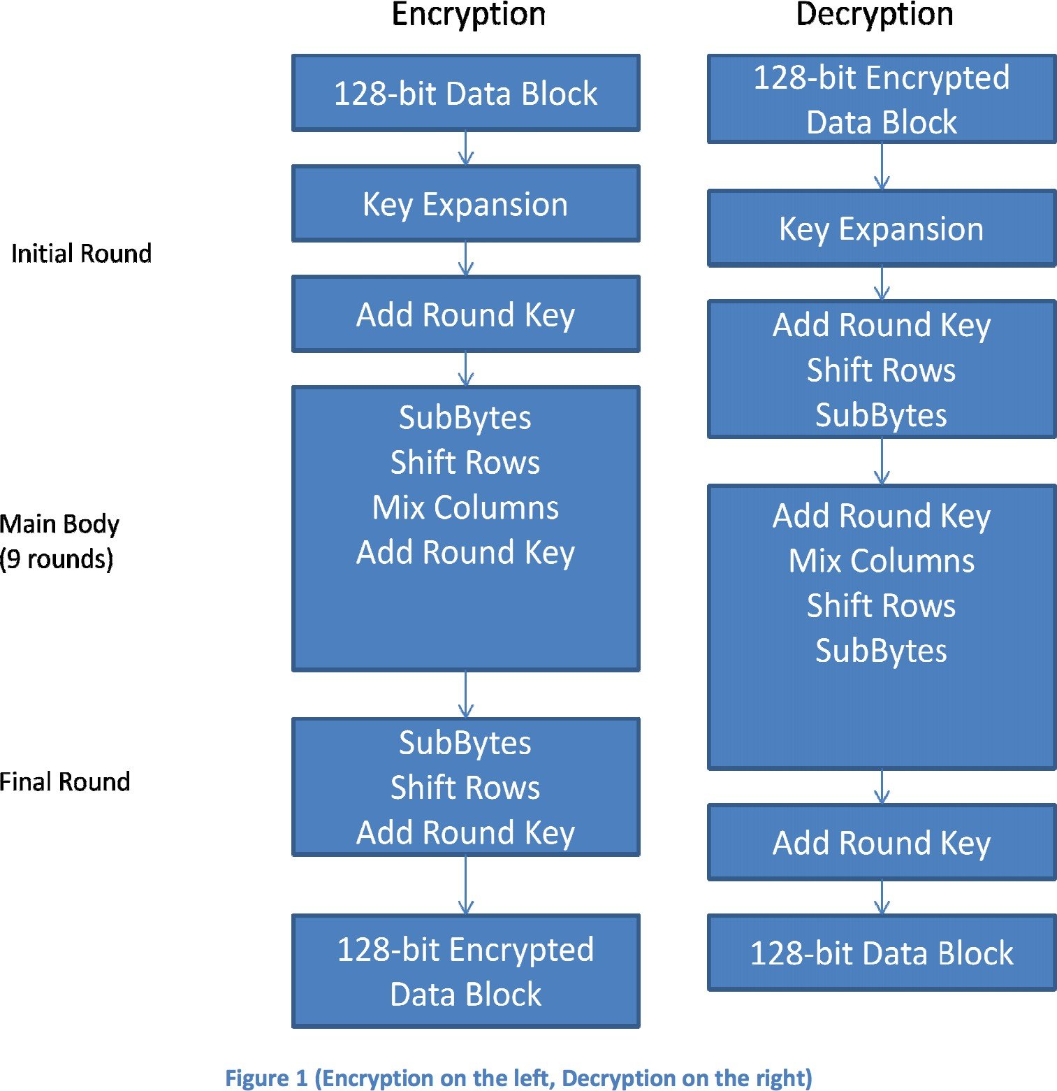

Slide 13
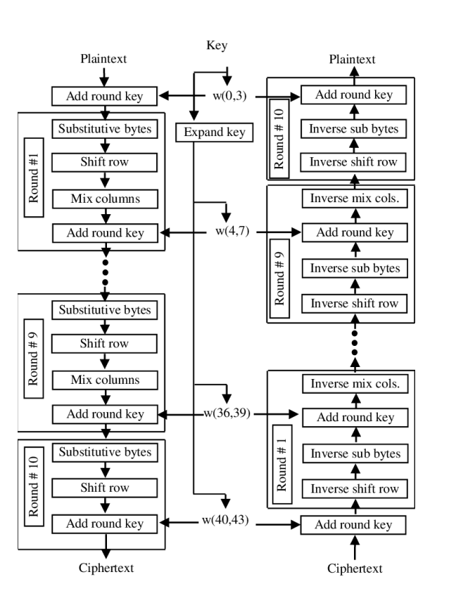

Slide 14
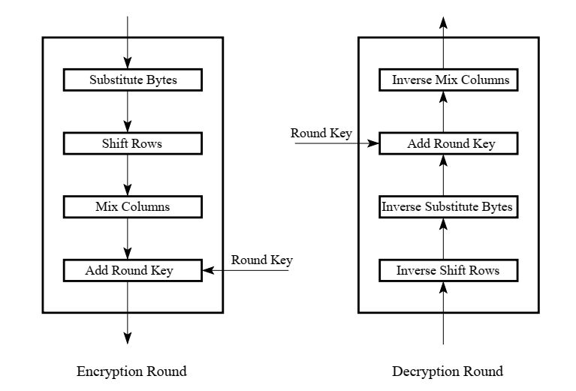

Slide 15
Analysis of Steps: Key Expansion
Key Expansion: In the key expansion process the given 128 bits cipher key is stored in a [4]x[4] byte matrix (16*8=128 bits) and then the four column words of the key matrix is expanded into a schedule of 44 words (44*4=176 bytes) resulting in 11 round keys.
Number of round keys = N_{r} + 1. Where N_{r} is the number of rounds (which is 10 in case of 128 bits key size). So, here, number round keys = 11.

Slide 16
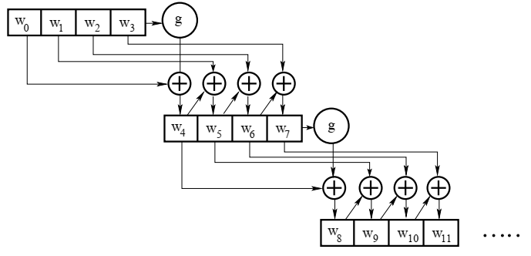
Analysis of Steps: Key Expansion

Slide 17
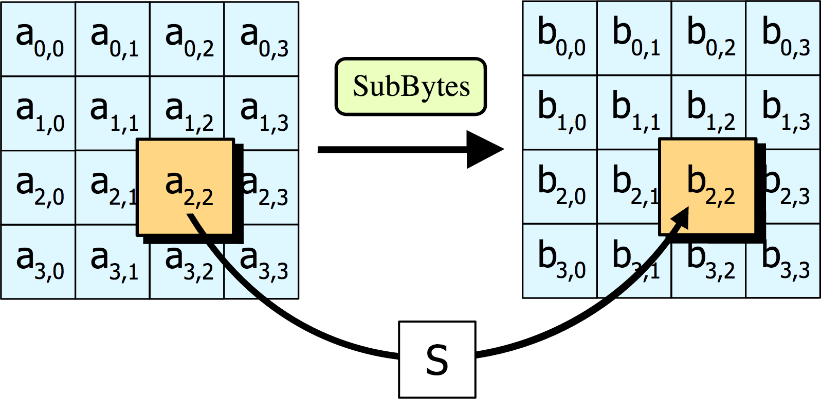
Analysis of Steps: Substitute Bytes
SubBytes: Each element of the matrix is replaced by an element of the S-box matrix.

Slide 18
Analysis of Steps: Substitute Bytes
SubBytes: Each element of the matrix is replaced by an element of the S-box matrix.
The S-box is a special lookup table which is constructed from Galois fields.
The Generating function used in this algorithm is GF(2⁸).
i.e., 256 values are possible
The elements of the S-box are written in hexadecimal system.

Slide 19
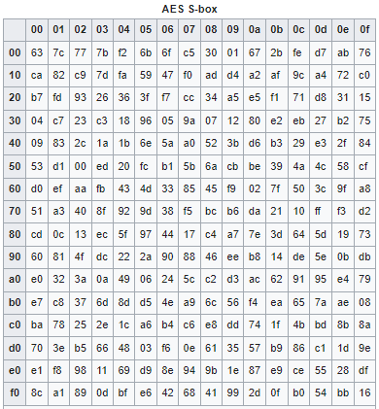
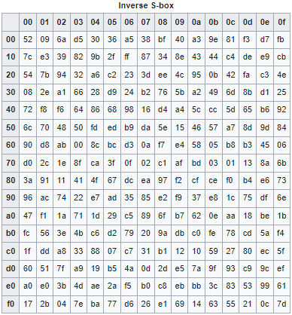
Analysis of Steps: Substitute Bytes

Slide 20
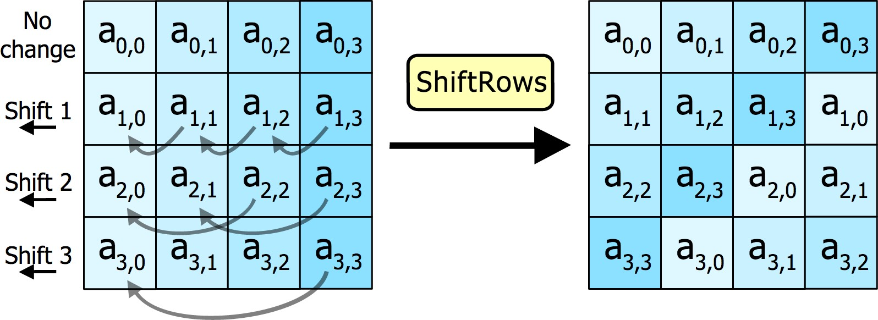
Analysis of Steps: Shift Rows
Shift Rows: In this step rows of the block are cylindrically shifted in left/right direction. The first row is untouched, the second one is shift by one, third one by two and the fourth one by three.

Slide 21
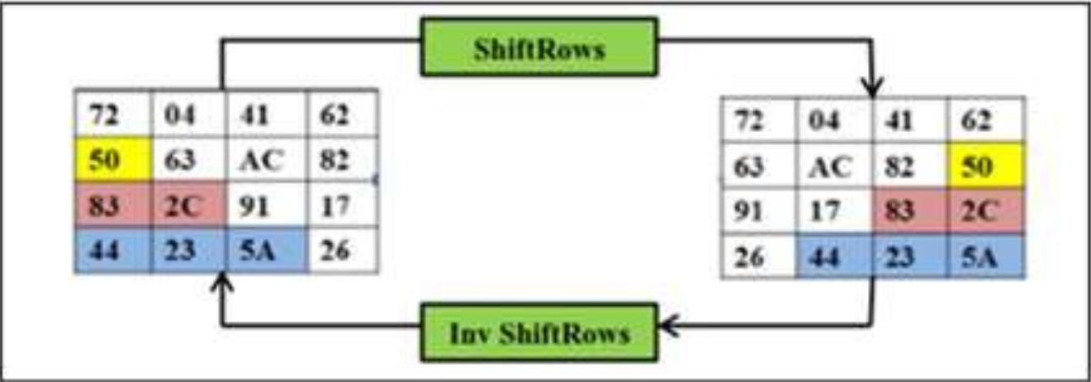
Analysis of Steps: Shift Rows

Slide 22
Analysis of Steps: Mix columns
Mix columns: This is the most important part of the algorithm. It causes the flip of bits to spread all over the block. In this step the block is multiplied with a fixed matrix. The multiplication is a field multiplication in galois field.
For each row there are 16 multiplication, 12 XORs and a 4 byte output.

Slide 23
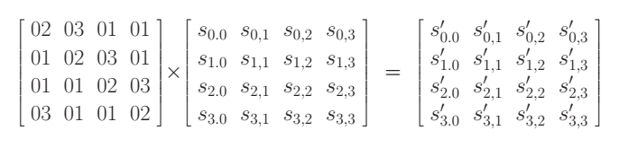
Analysis of Steps: Mix columns

Slide 24
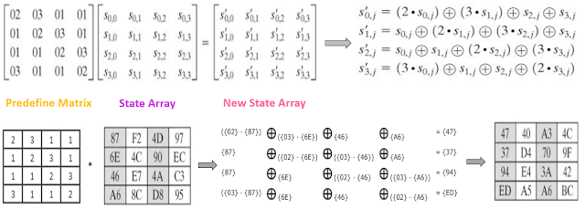
Analysis of Steps: Mix columns

Slide 25
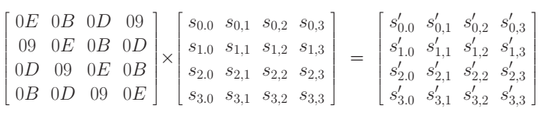
Analysis of Steps: Mix columns

Slide 26
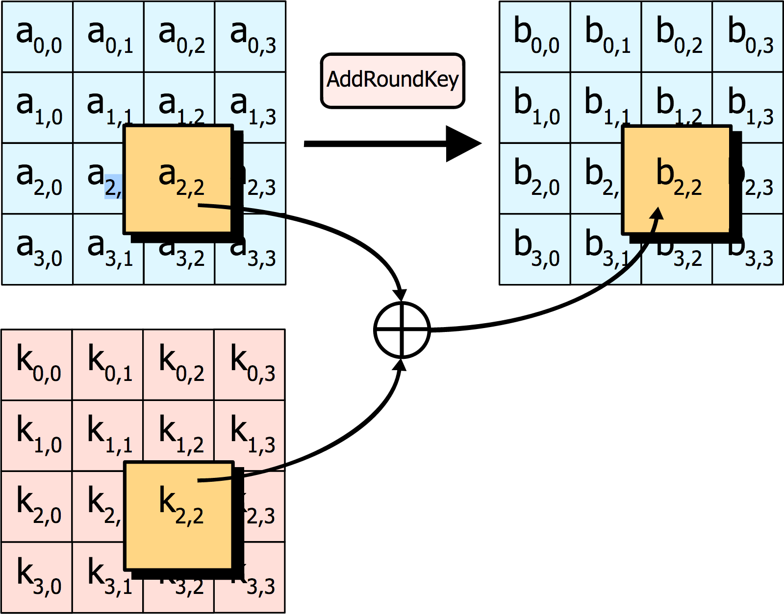
Analysis of Steps: Add round key
Add round key: In this step, each byte is XOR-ed with corresponding element of the key matrix.

Slide 27
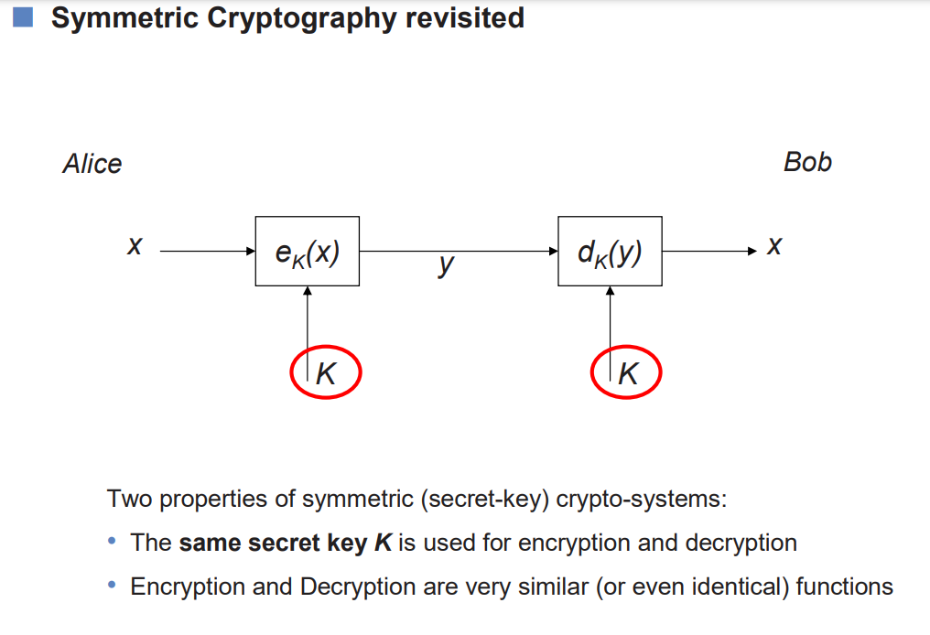

Slide 28
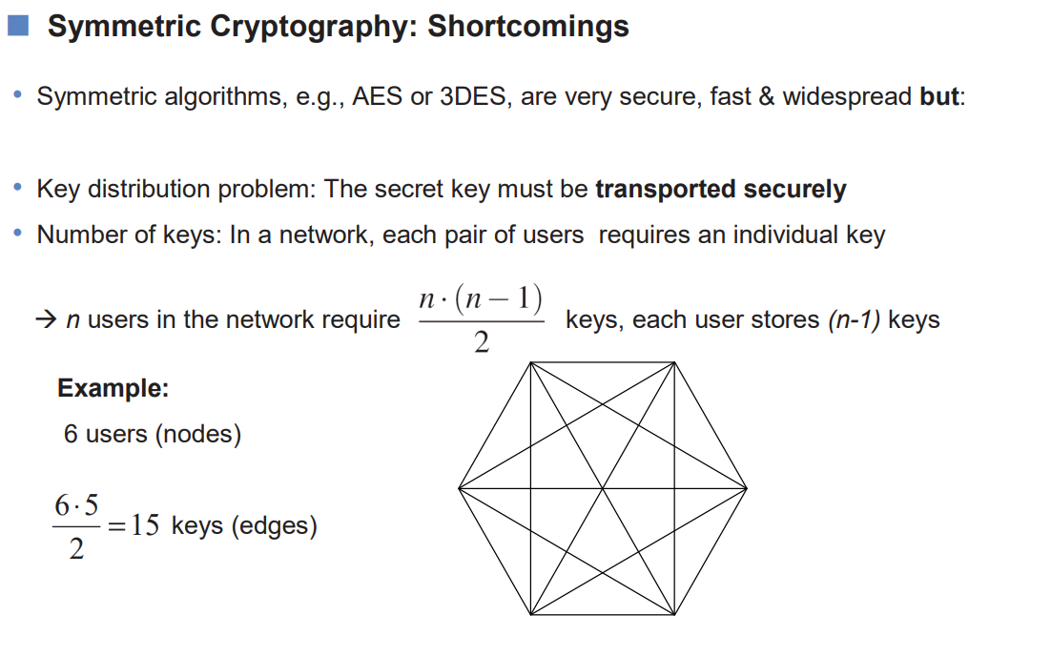

Slide 29
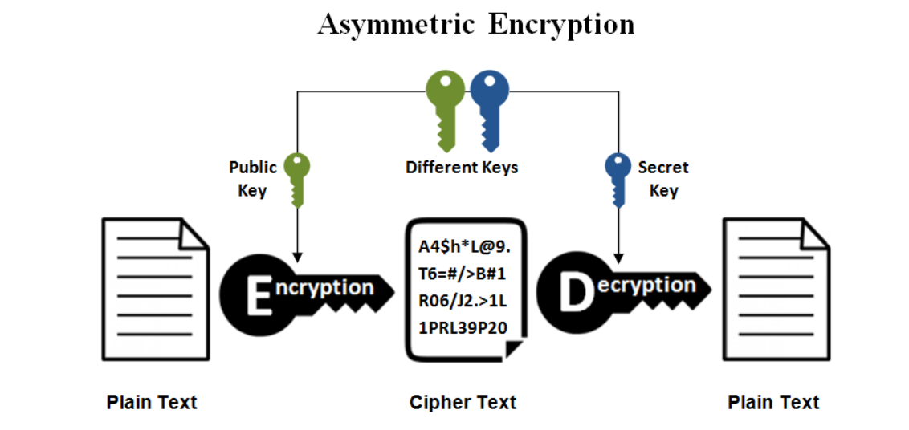
Asymmetric Cryptography

Slide 30
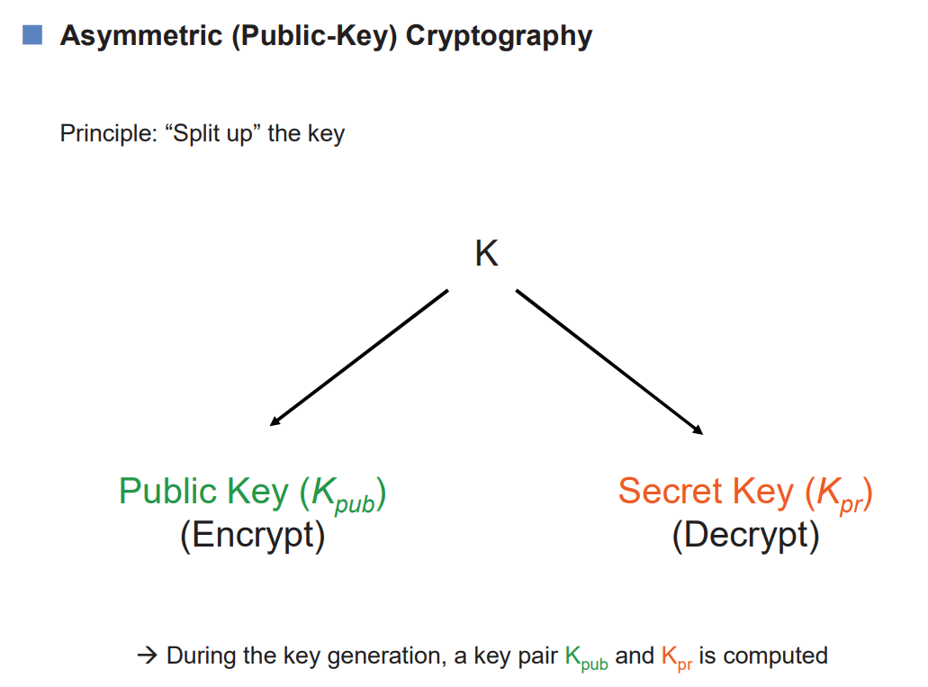

Slide 31
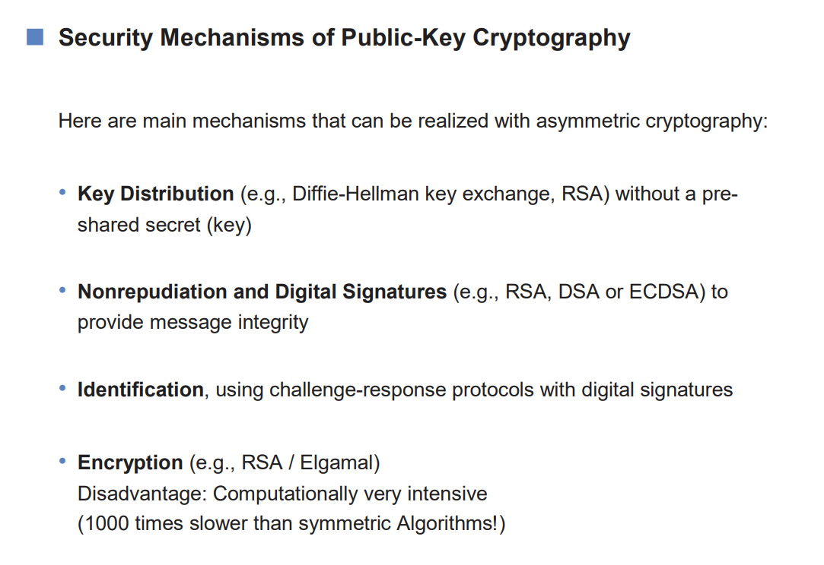

Slide 32
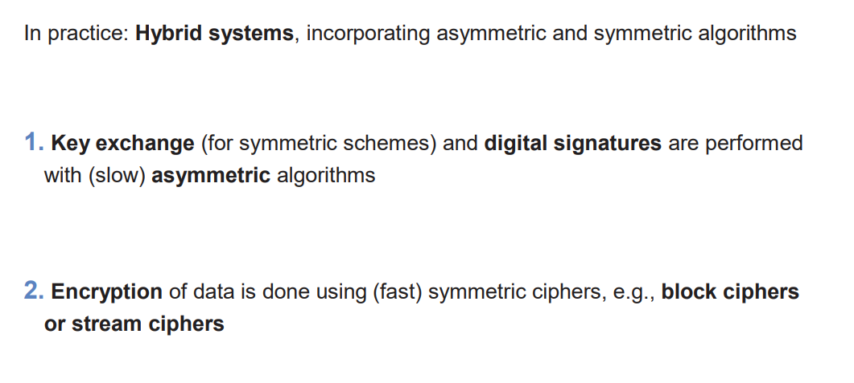

Slide 33
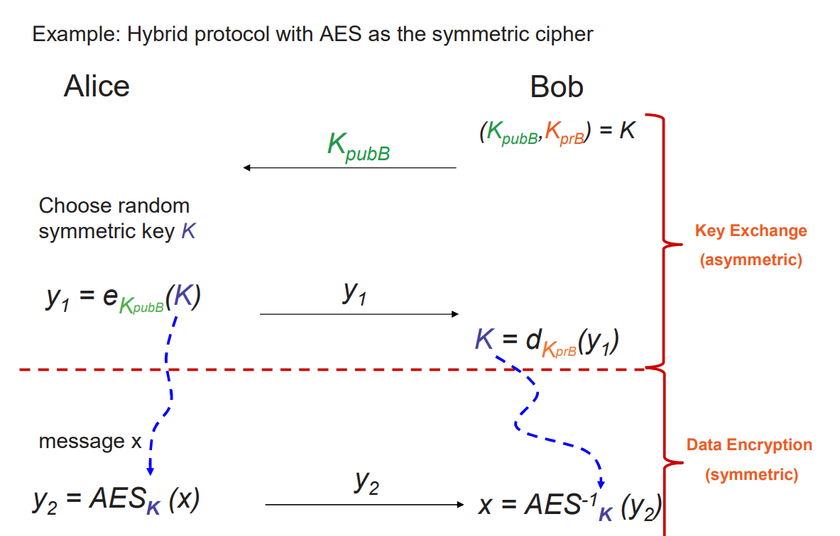


Slide 34
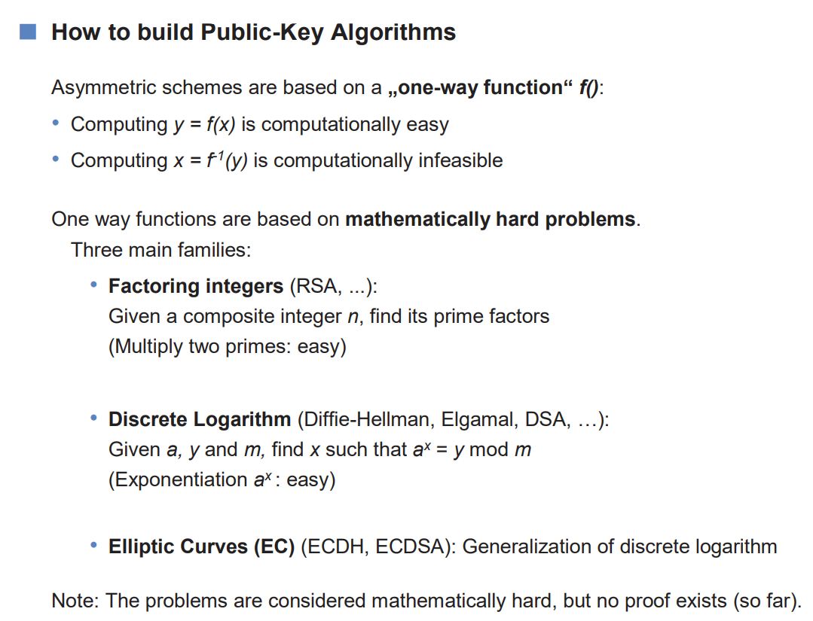

Slide 35
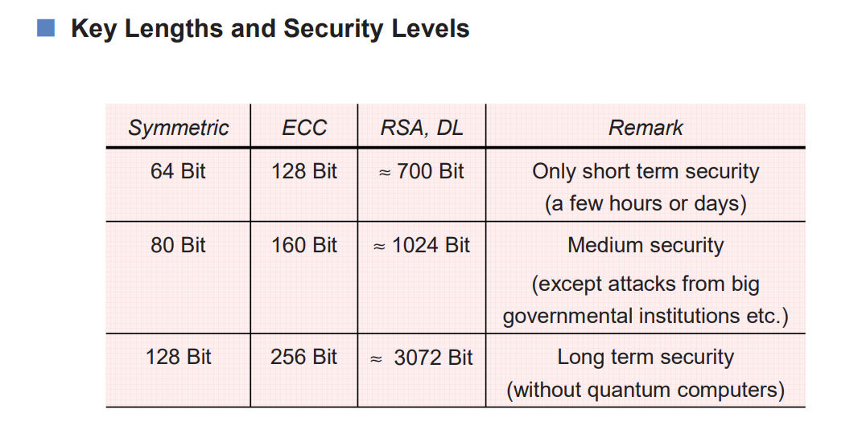

Slide 36
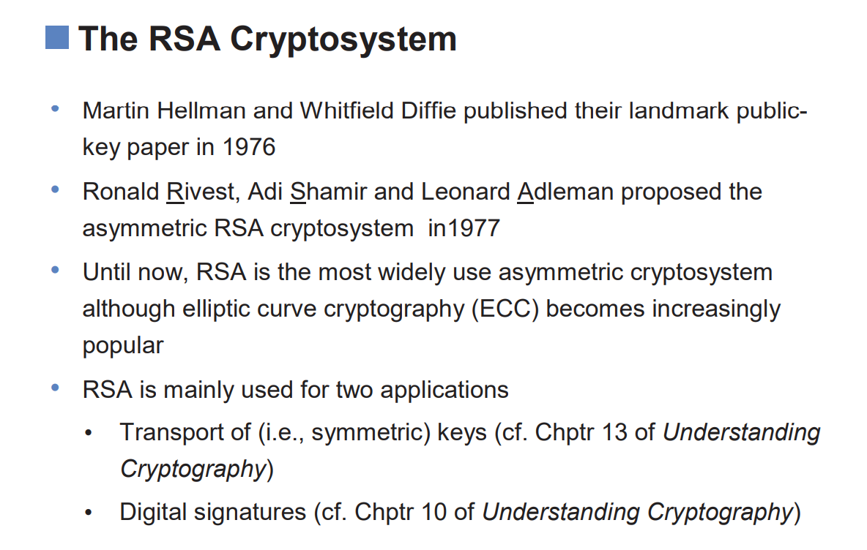

Slide 37
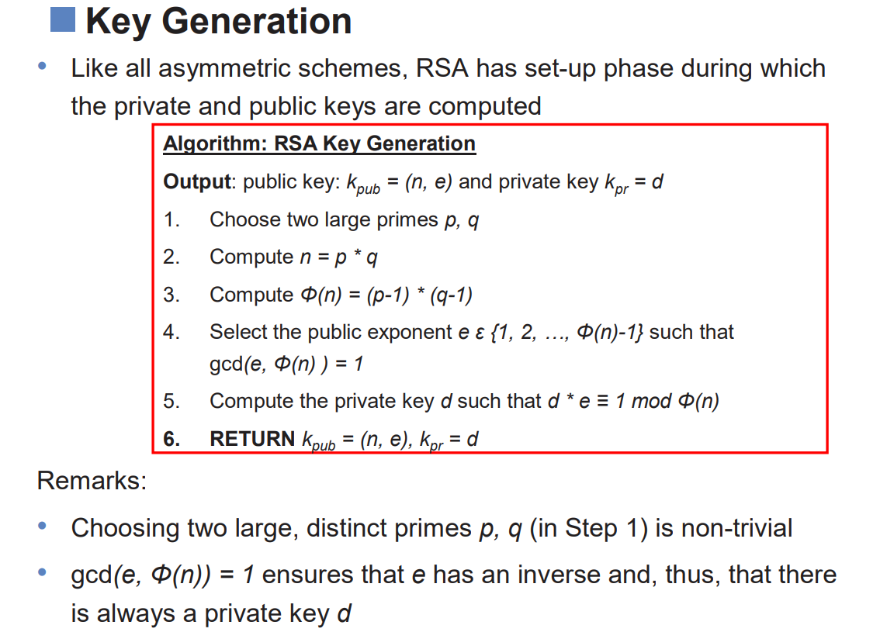

Slide 38
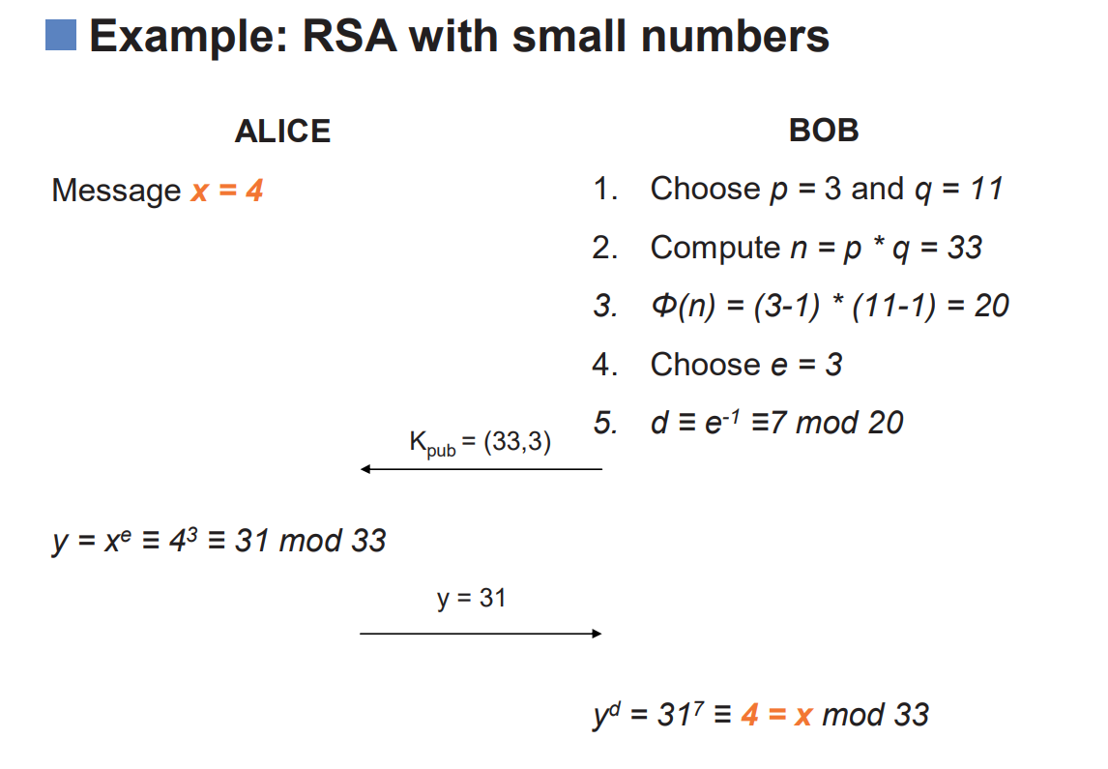

Slide 39
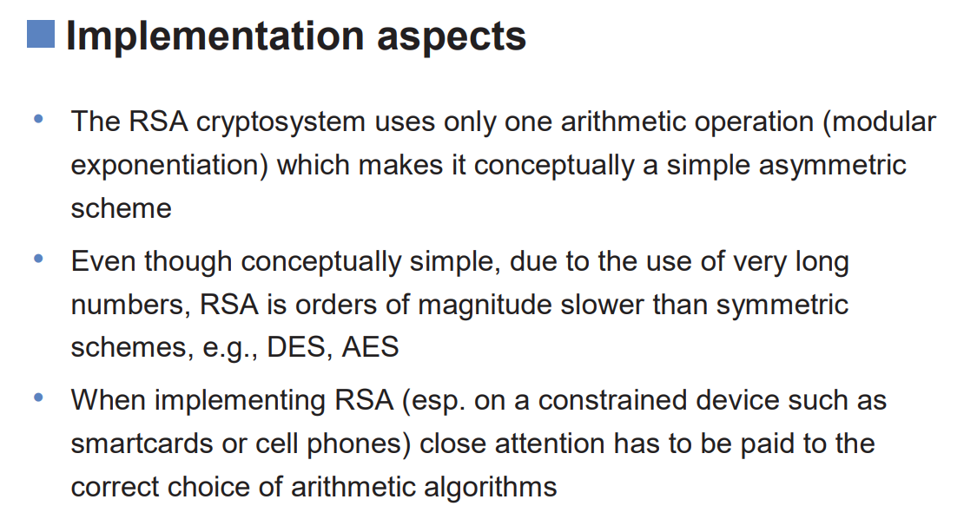

Slide 40
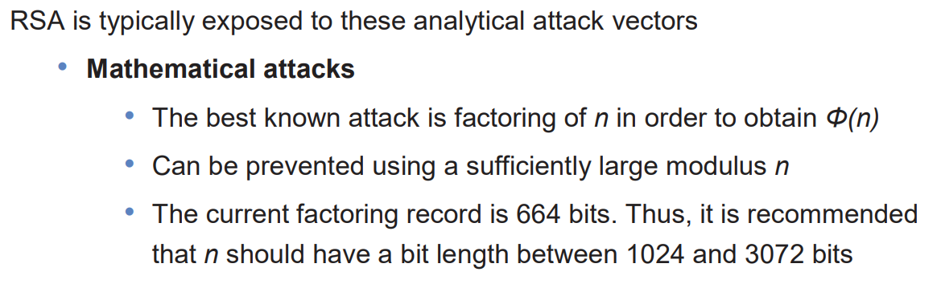

Slide 41
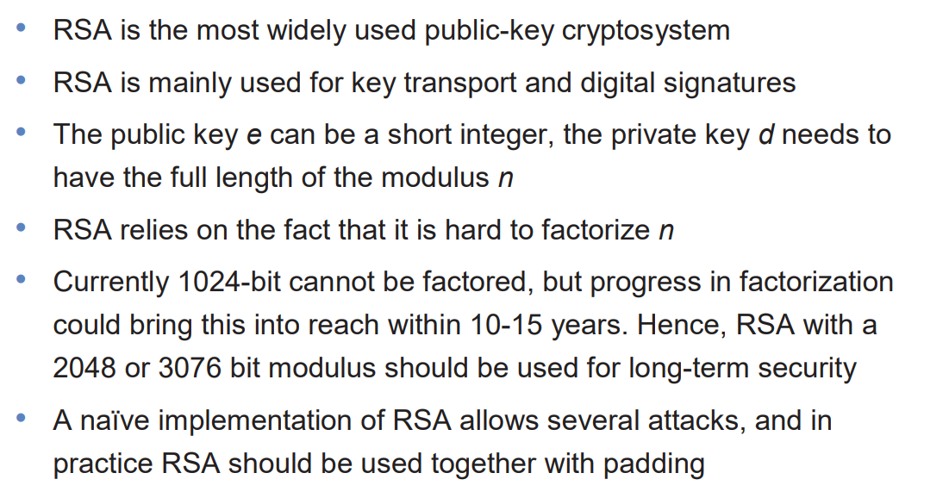

Slide 42
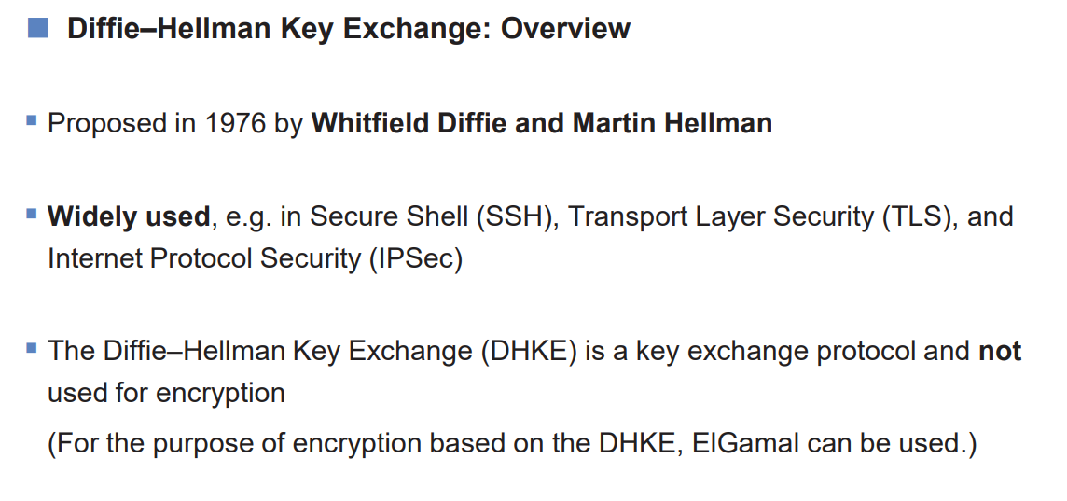

Slide 43
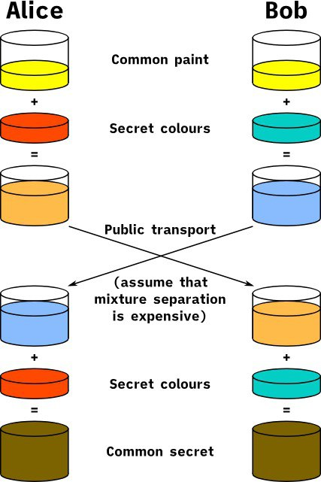
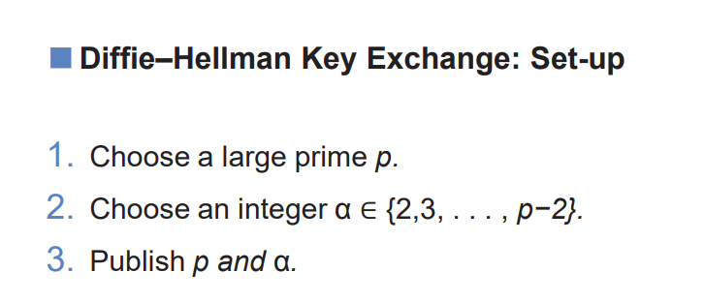

Slide 44
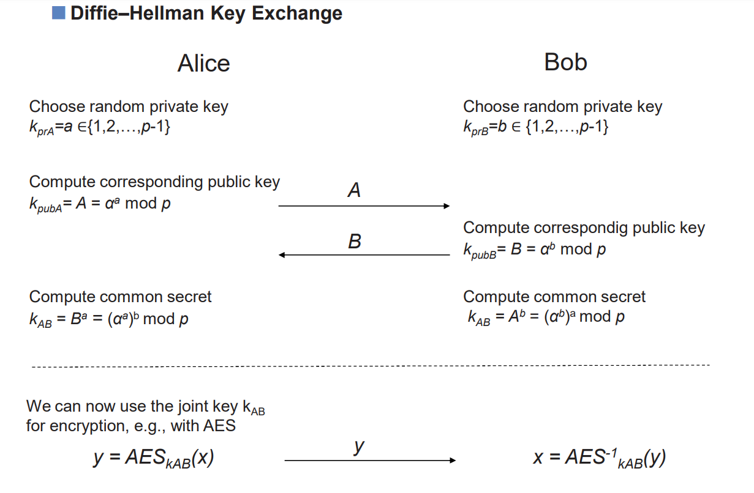

Slide 45
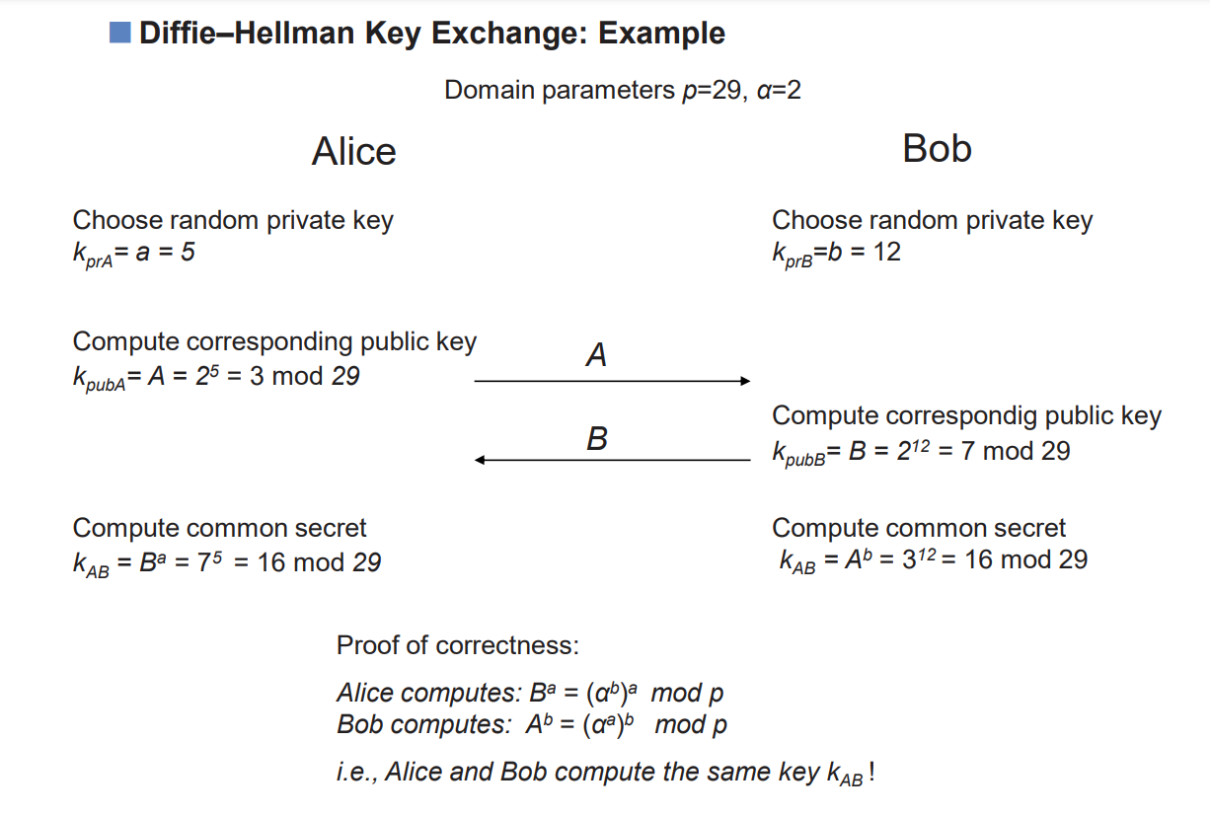

Slide 46
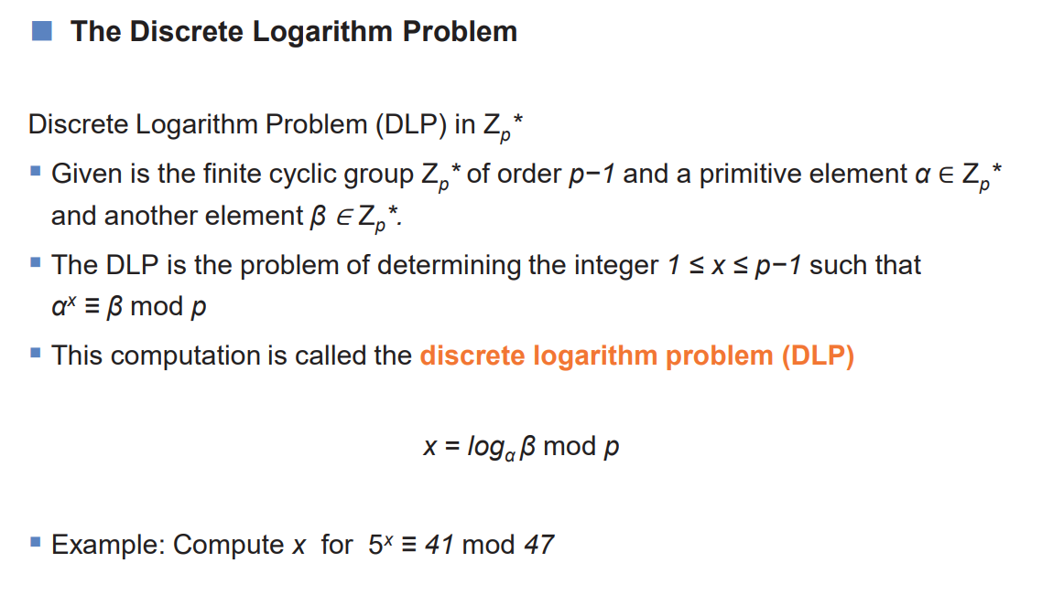

Slide 47
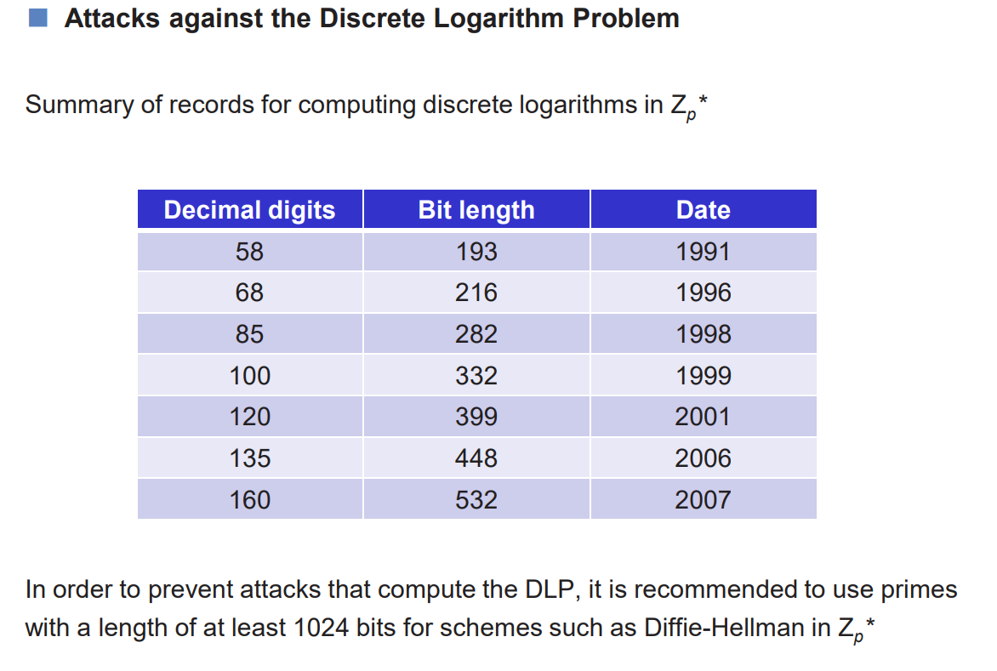

Slide 48
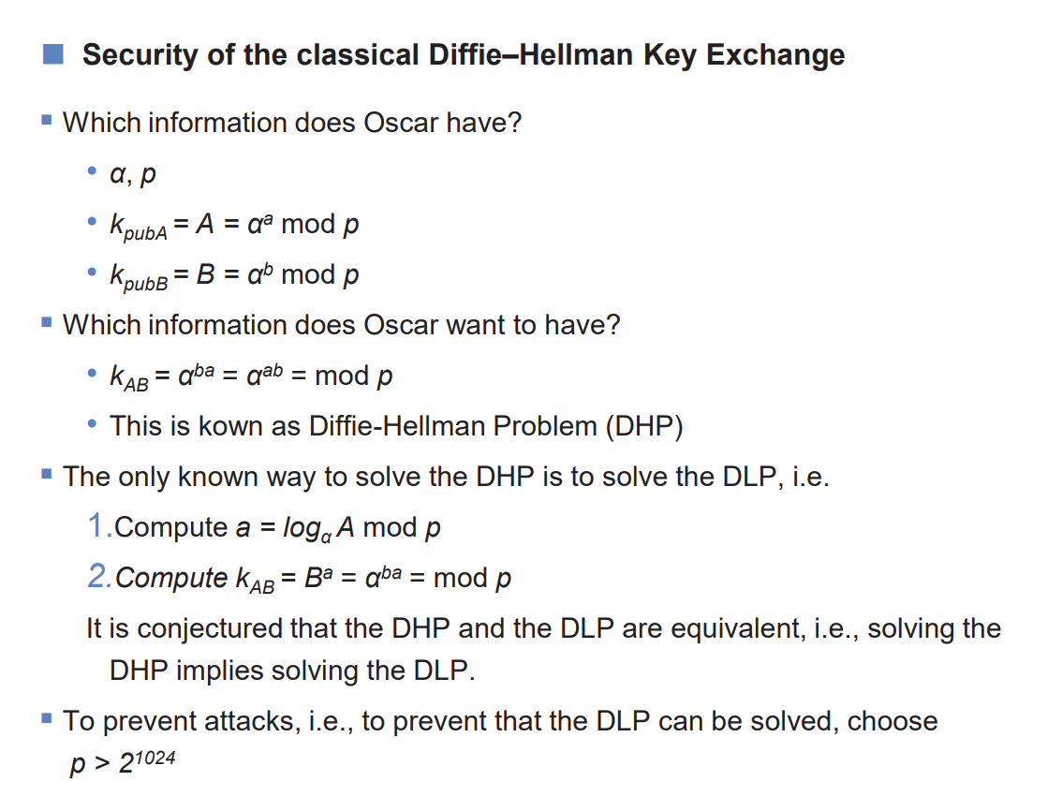

Slide 49
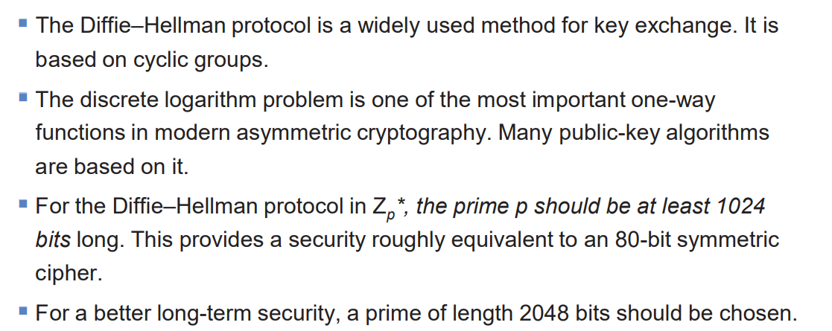

Slide 50
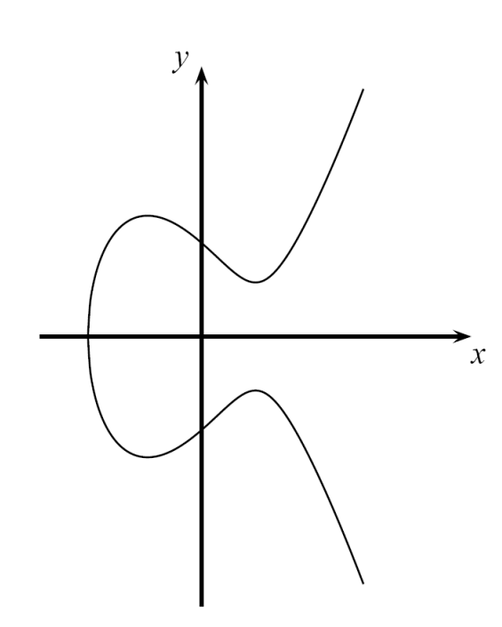
Elliptic Curve Cryptography

Slide 51
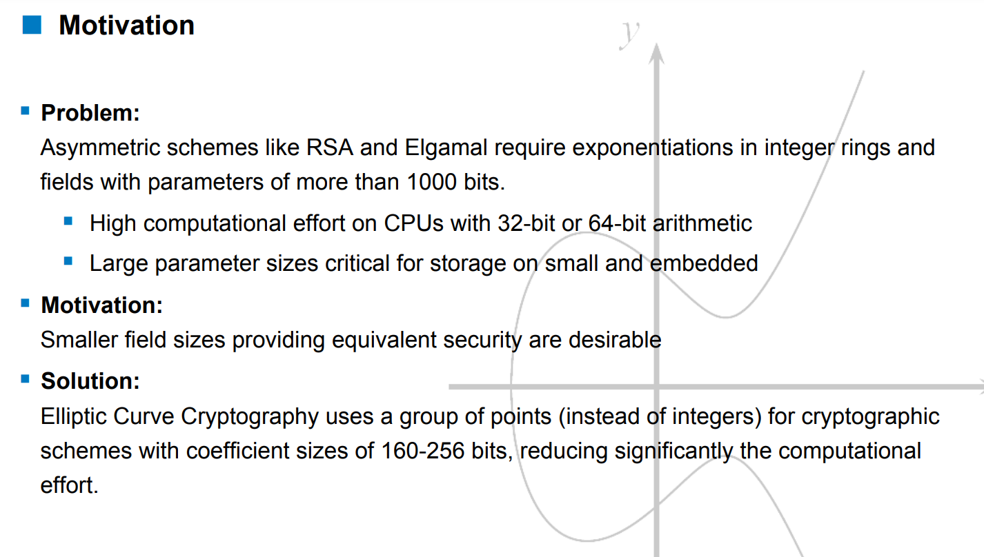

Slide 52
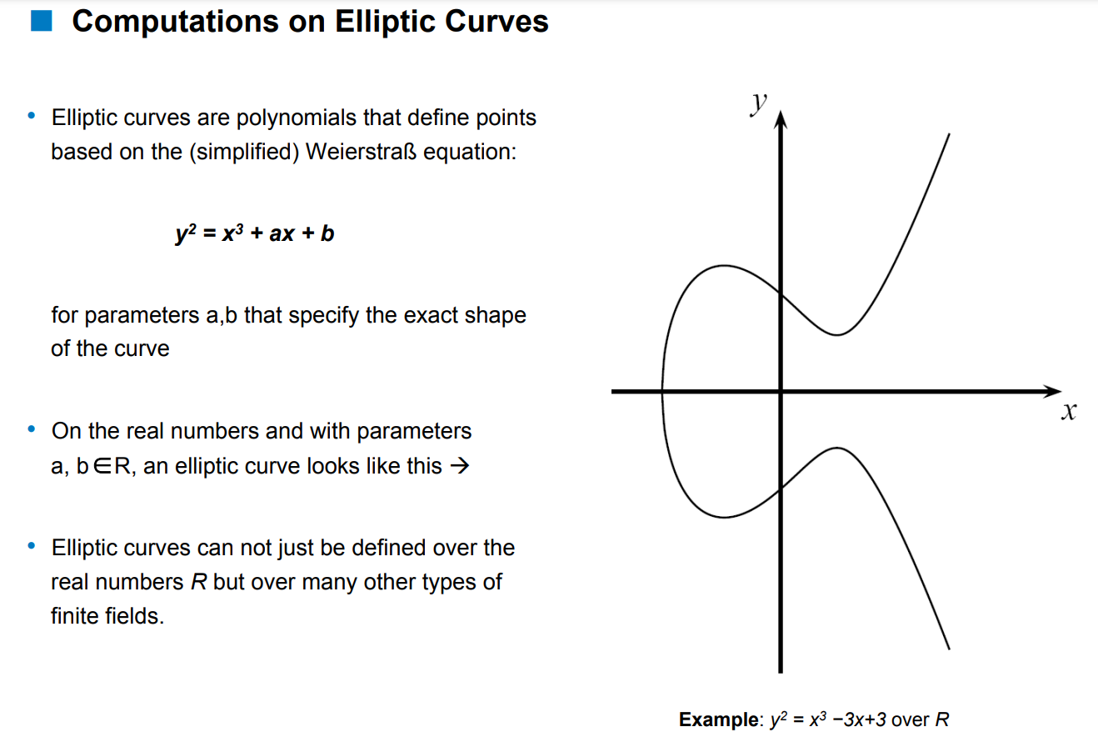

Slide 53
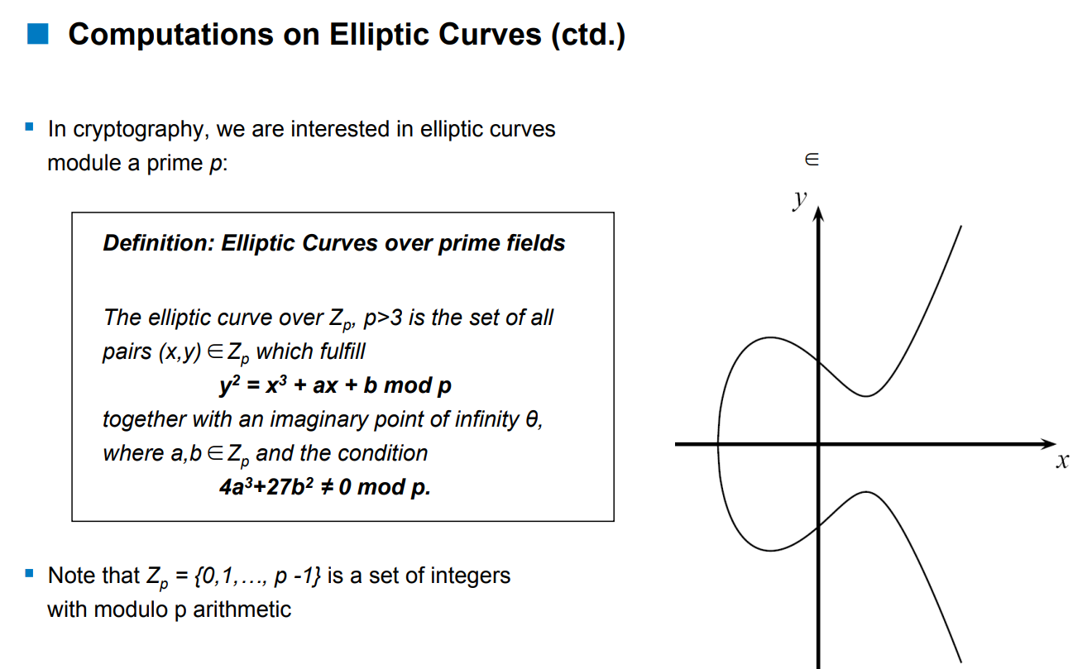
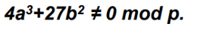
We will consider only those elliptic curves that have no multiple roots - which is equivalent to the condition

Slide 54
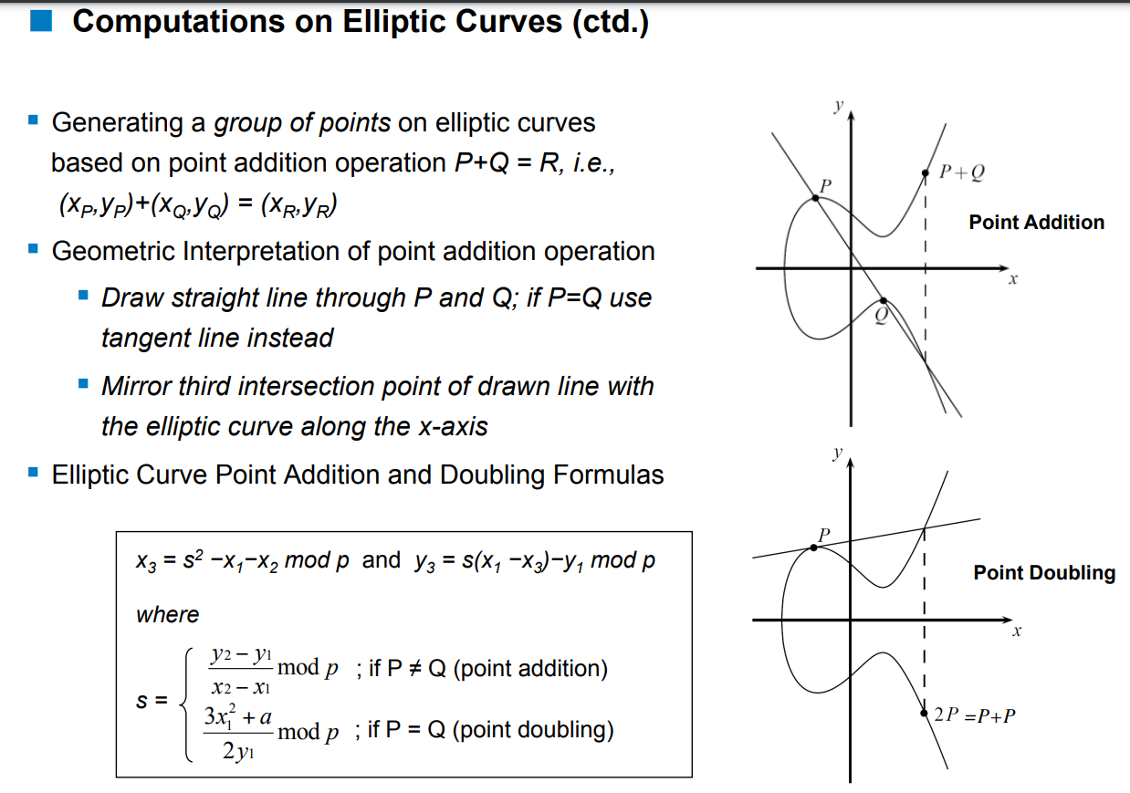

Slide 55
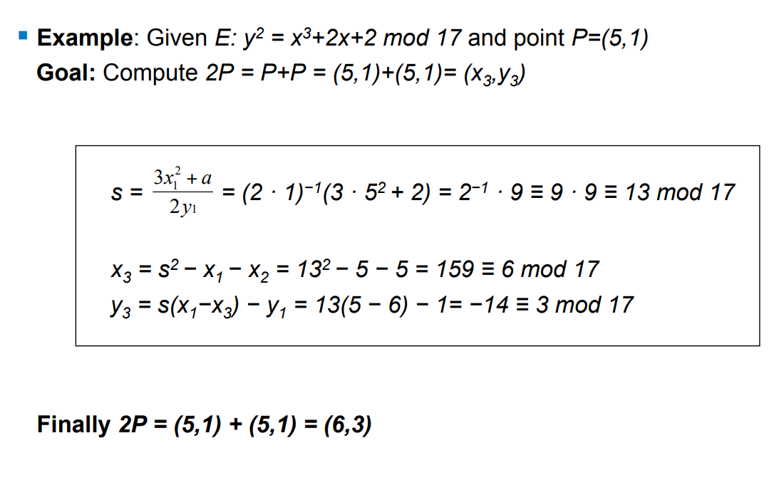

Slide 56


Slide 57


Slide 58
How to calculate 26P?

Slide 59


Slide 60


Slide 61


Slide 62


Slide 63


Slide 64
Links to follow
https://crypto-textbook.com/slides.php
https://www.youtube.com/watch?v=Q4X4OZTwftg&list=PLxP0p--aBHmIAeOBX1lkpTn-wAbAimg8-
https://www.youtube.com/watch?v=NF1pwjL9-DE&t=1s
https://www.youtube.com/watch?v=NmM9HA2MQGI

Slide 65


